Slide 1
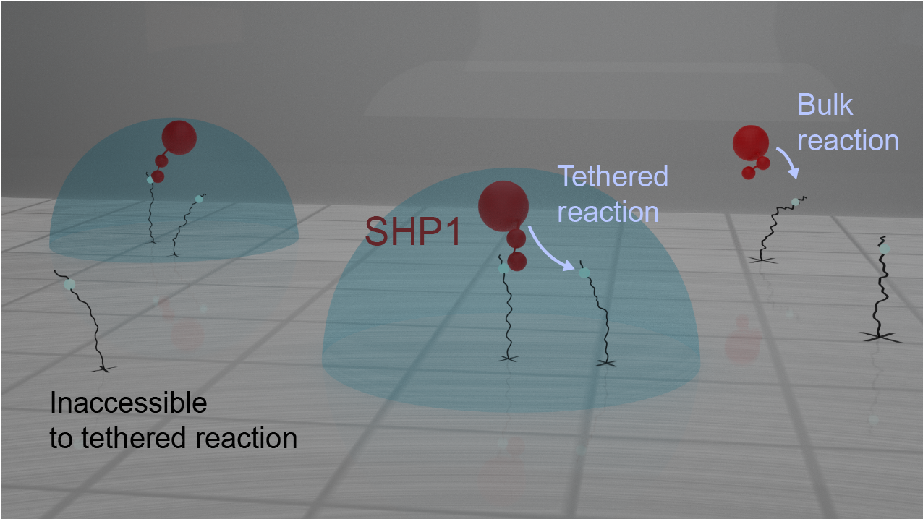
Blender Tutorial
Created by Katie Lynch (UCI Math 2021)
Modified by Jun Allard

Slide 2
OUTLINE
Introduction
Part 1
Basic Navigation
Object Mode
Part 2
Edit Mode
Materials
Part 3
Materials
Lighting
Rendering

Slide 3
OUTLINE
Introduction
Part 1
Basic Navigation
Object Mode
Part 2
Edit Mode
Materials
Part 3
Materials
Lighting
Rendering

Slide 4
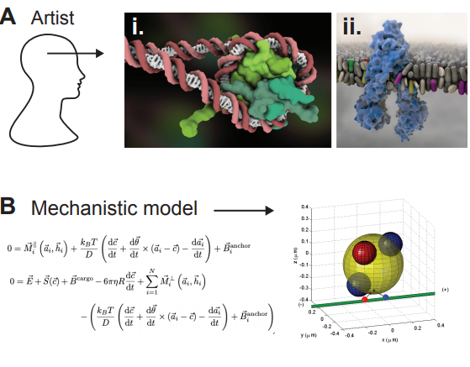
Scientific Visualization
Mechanistic model: scientifically accurate, but not visually appealing
Artistic model: visually appealing, but can be inaccurate

Slide 5
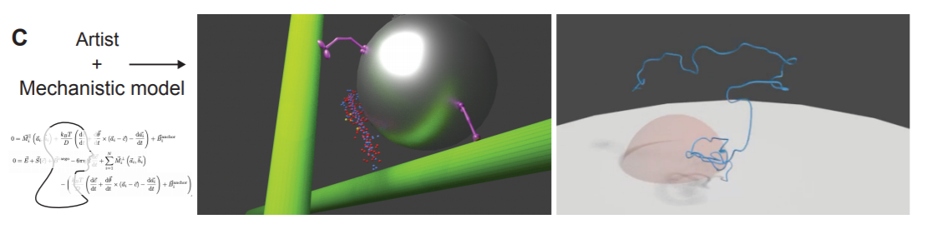
Scientific Visualization

Slide 6
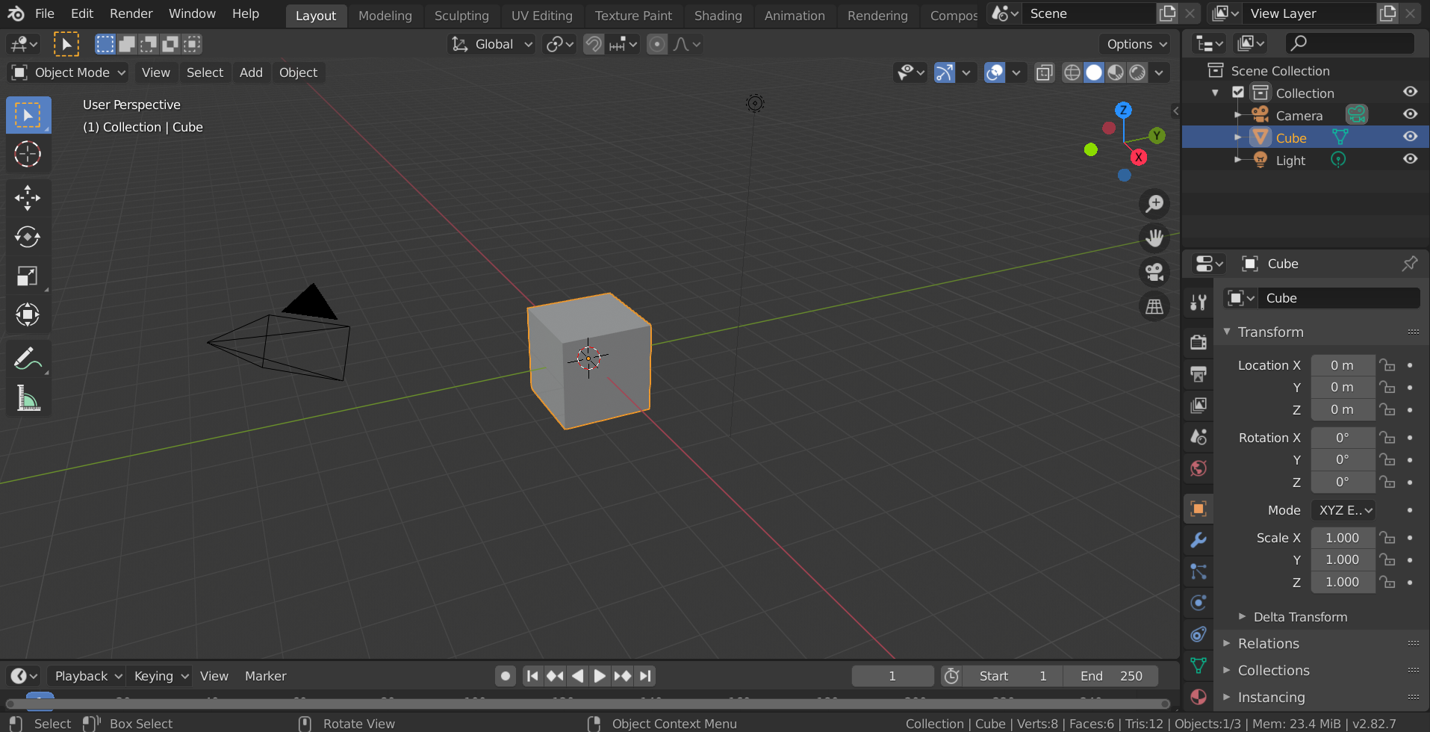
What is Blender?

Slide 7
Why Blender?
Pros
Cons
Versatile
Scientifically accurate
3D environment
Python console
Visually appealing
Easily accessible
Free and open source
Lots of tutorials and documentation
Complicated
Steep learning curve
Rendering time

Slide 8
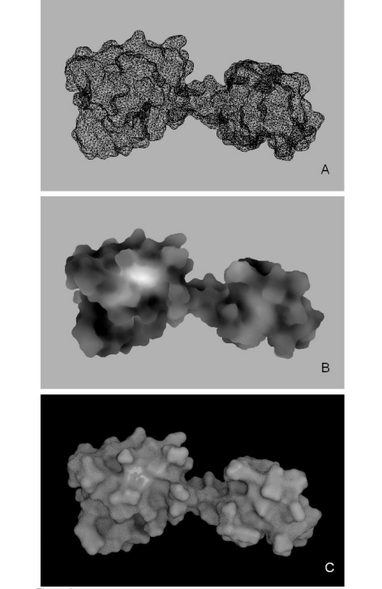
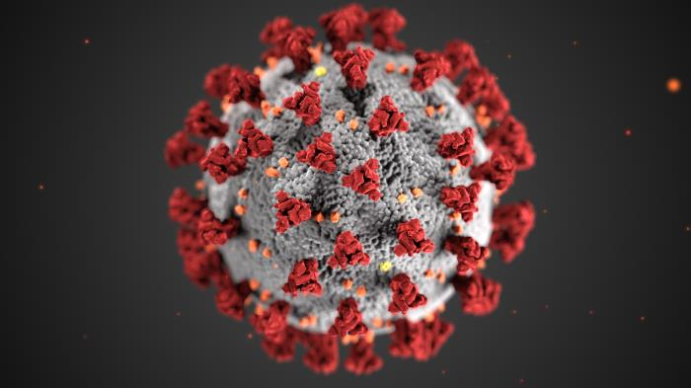
Blender and Science
CDC / Alissa Eckert, MSMI; Dan Higgins, MAMS
Andrei et al. 2012

Slide 9
Blender and Science: SHP1

Slide 10
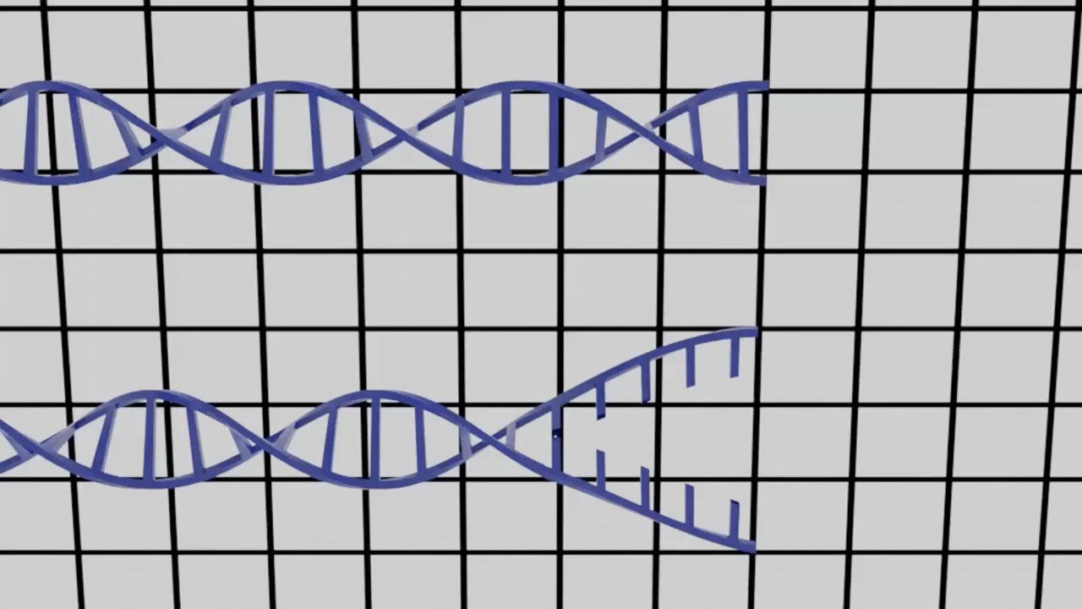
Blender and Science: RAD51 and DNA Repair

Slide 11
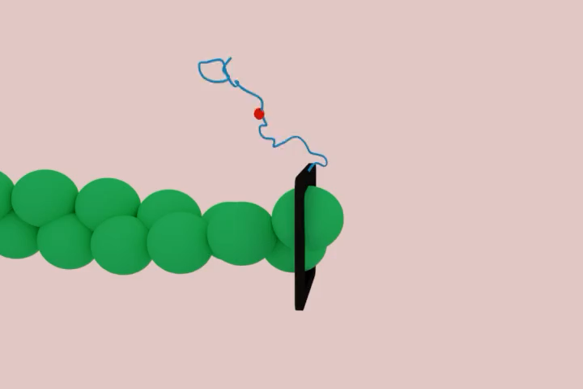
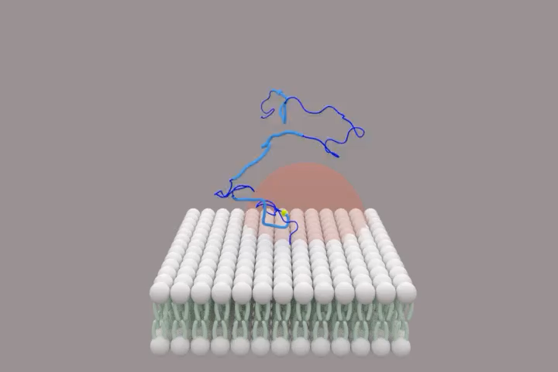
Blender and Science: Formin cytoskeleton assembly

Slide 12
A Final Example: DNA Methylation

Slide 13
OUTLINE
Introduction
Part 1
Basic Navigation
Object Mode
Part 2
Edit Mode
Materials
Part 3
Materials
Lighting
Rendering (on a server)

Slide 14
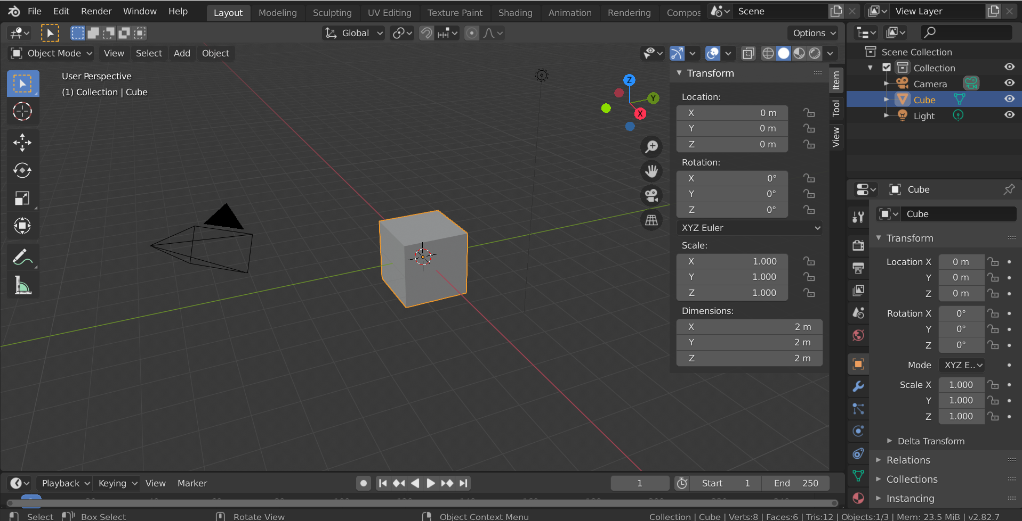
3D Viewport
Properties Panel
Change Object Information
Left and Right Panels
Basic actions
edit objects
Animation Panel

Slide 15
Moving Around
Moving around
Middle mouse button: click to orbit, scroll to zoom
Shift + middle mouse button: pans
Viewpoints
Numberpad 7: Top
Numberpad 1: Front
Numberpad 3: Side
Numberpad 0: Camera View
Hotkeys
R+middle mouse: pan view
Middle mouse: rotate view
Scroll middle mouse: zoom in/out
Numberpad 7: Top
Numberpad 1: Front
Numbmerpad 3: Side

Slide 16
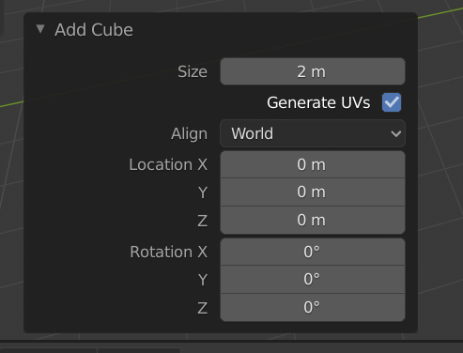
Object Mode
Delete object
Create object
When first creating an object, you can edit it
Changing object
Select object by right clicking on it
Scaling: S key
Moving: G key
Rotating: R key
Hotkeys
R+middle mouse: pan view
Middle mouse: rotate view
Scroll middle mouse: zoom in/out
Numberpad 7: Top
Numberpad 1: Front
Numbmerpad 3: Side
X: Delete
Shift+a: create object
S: scale object
G: move object
R: rotate object
T: toolbar
N: right hand toolbar
Ctrl+z: undo

Slide 17
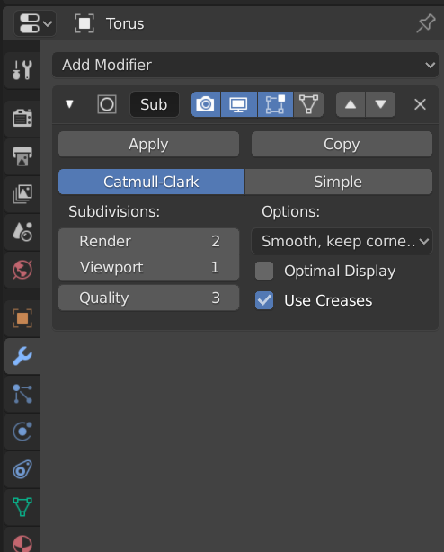
Object Mode
Always create an object with low resolution
This becomes a problem later when rendering
Use modifiers instead
Subdivision modifier
Shade smooth

Slide 18
Small Groups
Delete cube
Create a donuts (torus)
Create a table (plane)
Position objects
Hotkeys
R+middle mouse: pan view
Middle mouse: rotate view
Scroll middle mouse: zoom in/out
Numberpad 7: Top
Numberpad 1: Front
Numbmerpad 3: Side
X: Delete
Shift+a: create object
S: scale object
G: move object
R: rotate object
T: toolbar
N: right hand toolbar
Ctrl+z: undo

Slide 19
OUTLINE
Introduction
Part 1
Basic Navigation
Object Mode
Part 2
Edit Mode
Modeling
Part 3
Materials
Lighting
Rendering

Slide 20
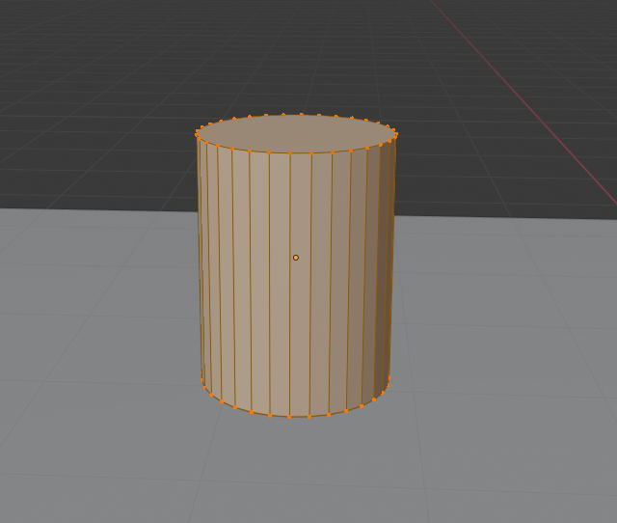
Edit Mode
Always start with an object close to the desired end shape
Allows manipulation of object shapes
Can move (G) and rotate (R) vertices, edges, and planes
Hotkeys in Edit Mode
Tab: enter / exit edit mode
O: proportional edit
Shift: select multiple
B: box select
Alt+left mouse: select entire row/column
Ctrl+R: create loop
i: insert
E: extrude

Slide 21
Small Groups
Create a cup
Start with a cylinder
Use edit mode to model
Hotkeys
R+middle mouse: pan view
Middle mouse: rotate view
Scroll middle mouse: zoom in/out
Numberpad 7: Top
Numberpad 1: Front
Numbmerpad 3: Side
X: Delete
Shift+a: create object
S: scale object
G: move object
R: rotate object
T: toolbar
N: right hand toolbar
Ctrl+z: undo
Hotkeys in Edit Mode
Tab: enter / exit edit mode
O: proportional edit
Shift: select multiple
B: box select
Alt+left mouse: select entire row/column
Ctrl+R: create loop
i: insert
E: extrude

Slide 22
OUTLINE
Introduction
Part 1
Basic Navigation
Object Mode
Part 2
Edit Mode
Materials
Part 3
Materials
Lighting
Rendering

Slide 23
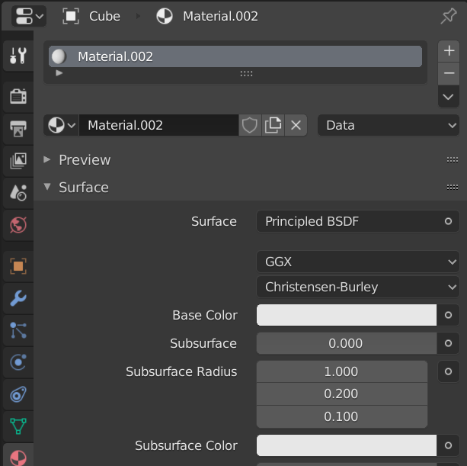
Materials and Modifiers
Use materials tab on right hand side to add a material
Basic options include color
Use modifiers tab on right hand side to smooth the object
Subdivision surface adds vertices
Use a low number in viewport
Many other useful modifiers
Other options: shade smooth

Slide 24
Lighting
Four types of lights
Point: lighting in all directions
Sun: only angle matters in positioning
Spot lamp: limited area, allows focus on one object
Area lamp: similar to spot, but wider focus
Changing the background to a lighter color contributes to lighting
Never use as primary light source
Washes out the scene
Generally want one primary light source for a scene

Slide 25
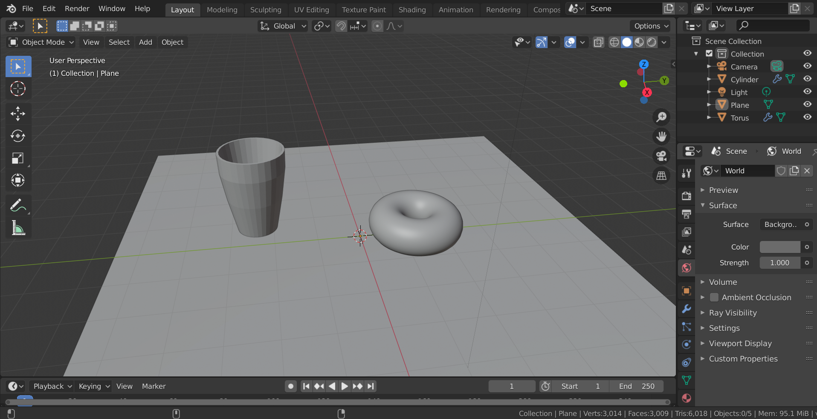
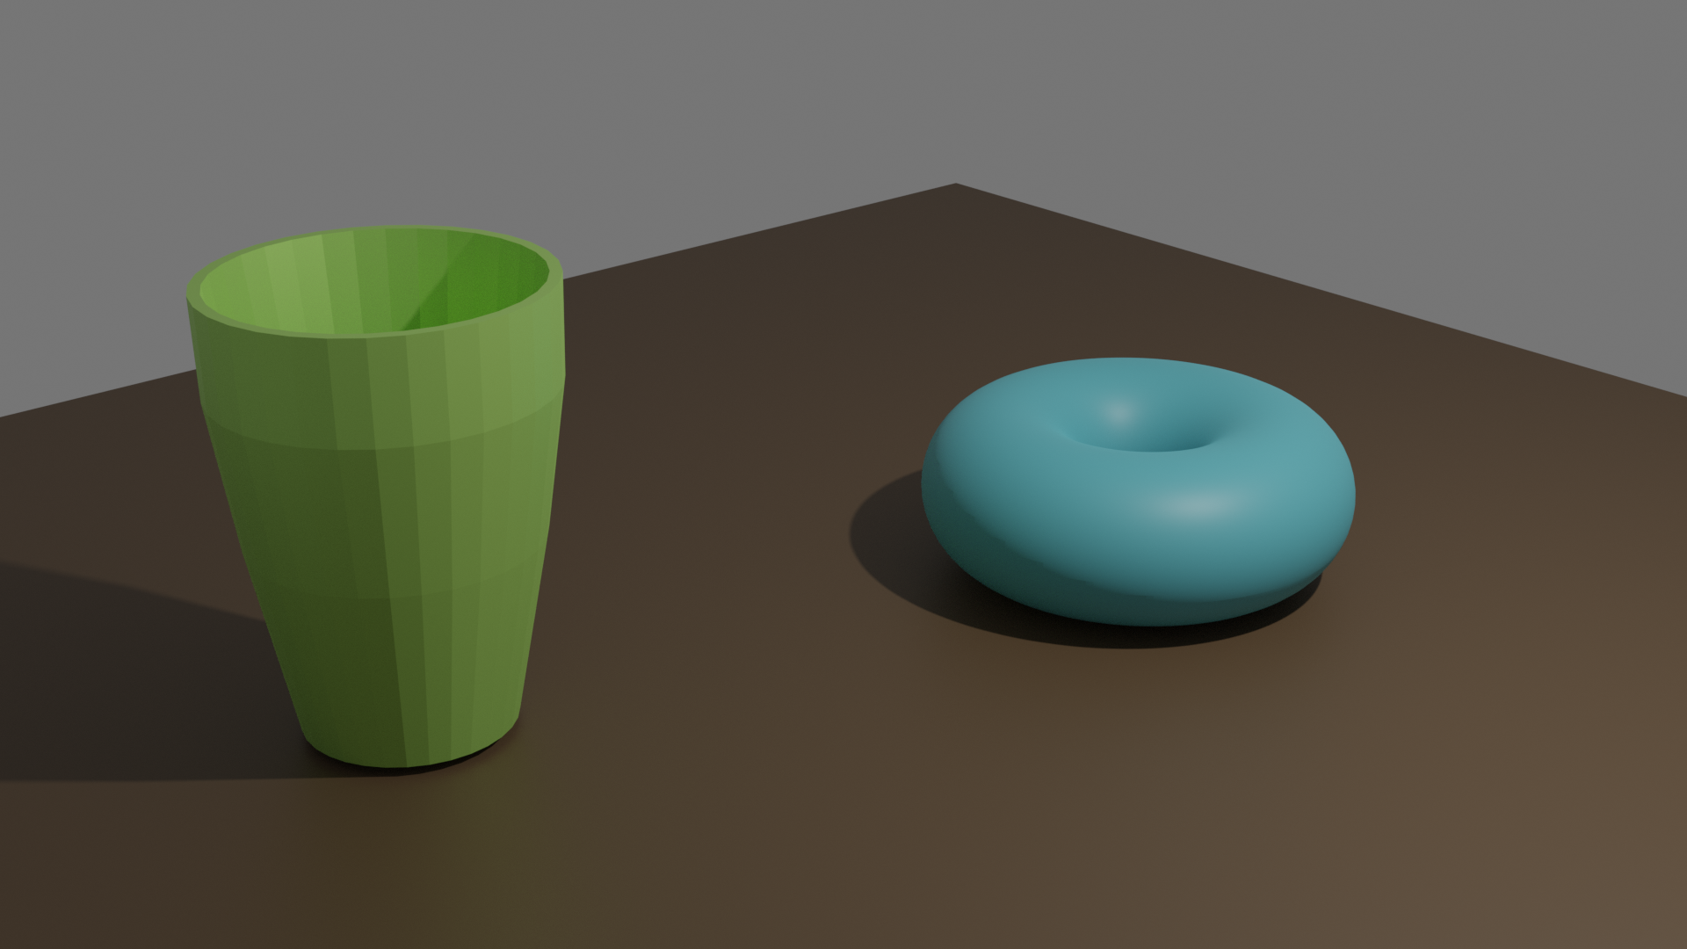
Rendering
What affects rendering time?
GPU vs CPU
Scene complexity
Quality of output
Tile size
Resolution of image
Getting the final product
Can render still image (.png)
Or animated movie (.mkv)

Slide 26
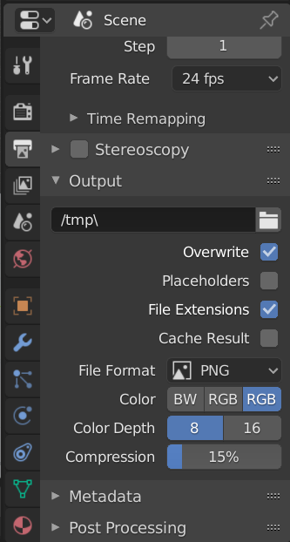
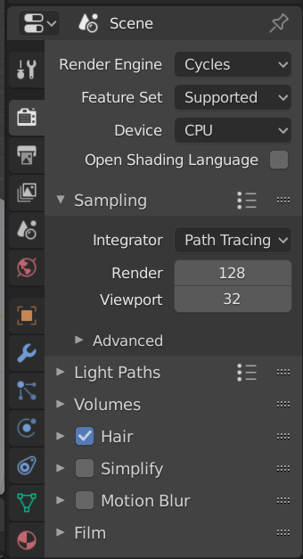
How to Render
Assuming camera is in the right position, you will want to check the following options before rendering:
Rendering properties
Rendering engine (cycles)
GPU vs. CPU
Output properties
Where image will output
What type of image (png)
Resolution

Slide 27
Small Groups
Change to cycles rendering engine
Use subdivision surface modifier
Use “shade smooth” for donut
Add materials for donut, cup, and table
Render on your laptop if
you want, or…
Hotkeys
R+middle mouse: pan view
Middle mouse: rotate view
Scroll middle mouse: zoom in/out
Numberpad 7: Top
Numberpad 1: Front
Numbmerpad 3: Side
X: Delete
Shift+a: create object
S: scale object
G: move object
R: rotate object
T: toolbar
N: right hand toolbar
Ctrl+z: undo
Hotkeys in Edit Mode
Tab: enter / exit edit mode
O: proportional edit
Shift: select multiple
B: box select
Alt+left mouse: select entire row/column
Ctrl+R: create loop
i: insert
E: extrude

Slide 28
Rendering Instructions
Local (on your laptop)
On server
Check the following options:
In the top menu, click render and then render image
Share result in the Google Drive!
Put .blend file in google drive. Make sure filename contains your name.
See Canvas for link to drive.
You need to use your UCI google account.
Rendering properties
Rendering engine (cycles)
GPU vs. CPU (CPU)
Output properties
Where image will output
What type of image (png)
Resolution

Slide 29
Thanks for listening!

